Slide 1
Responsive design

Slide 2
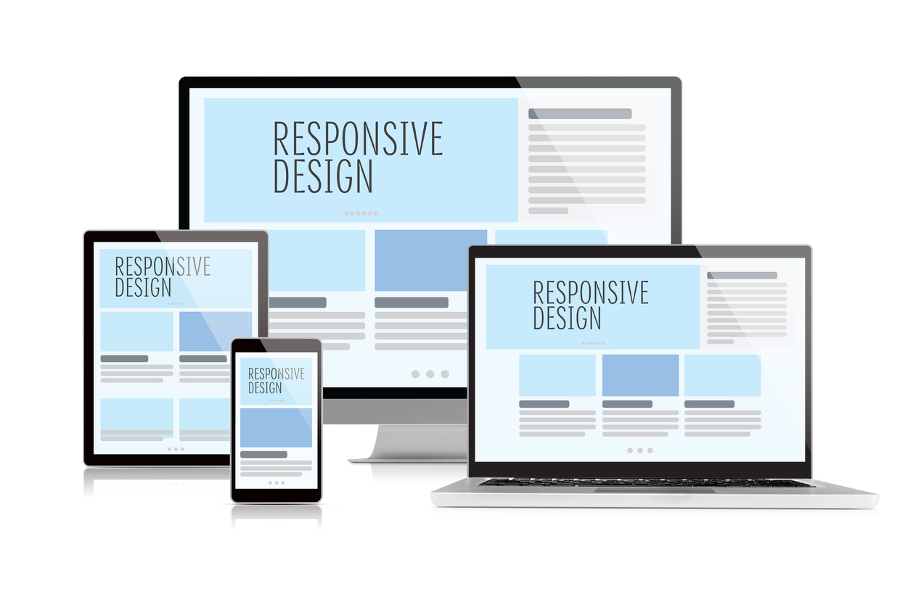
What is responsive design?
Responsive design is a technique used while creating websites so the web page and interactions respond to the user’s screen size, platform and orientation.
Notes:
https://www.webfx.com/blog/web-design/understanding-the-elements-of-responsive-web-design/

Slide 3
What is a media query?
Media query is a CSS technique introduced in CSS3. It uses the @media rule to include a block of CSS properties only if a certain condition is true.
Example:
If the browser window is 600px or smaller, the background color will be light blue:
@media only screen and (max-width: 600px) { body { background-color: lightblue; } }

Slide 4
Media queries can be used to check many things, such as:
width and height of the viewport
width and height of the device
orientation (is the tablet/phone in landscape or portrait mode?)
resolution
Take a look: https://www.w3schools.com/cssref/tryit.asp?filename=trycss3_media3

Slide 5
Normal breakpoints
/* Extra small devices (phones, 600px and down) */ @media only screen and (max-width: 600px) {...} /* Small devices (portrait tablets and large phones, 600px and up) */ @media only screen and (min-width: 600px) {...} /* Medium devices (landscape tablets, 768px and up) */ @media only screen and (min-width: 768px) {...} /* Large devices (laptops/desktops, 992px and up) */ @media only screen and (min-width: 992px) {...} /* Extra large devices (large laptops and desktops, 1200px and up) */ @media only screen and (min-width: 1200px) {...}

Slide 6
What are some tools to design responsively?
Bootstrap
A web framework that uses HTML, CSS and JS for responsive design. It was created by Twitter.
CSS Grid
A two-dimensional layout model that offers alignment in columns and row, like tables
Flexbox
A one-dimensional layout model that offers space distribution and alignment capabilities.

Slide 7
Flexbox should be thought of in two pieces
Properties applied to the container
Properties applied to the items (within the container)

Slide 8
Flex Container

Slide 9
The flexbox container
Defines the element as a flexbox container and establishes new formatting context for its contents.
.container { display: flex | inline-flex; }
Use either “flex” or “inline-flex” as a value.

Slide 10
Once you set the flex container...
All direct children become flex items.
A few other notes:
Items will stretch automatically to fill the size of the cross axis (column height in this case)
Items don’t stretch on the main axis but can shrink
// defaults .container { display: flex | inline-flex; flex-direction: row; flex-basis: auto; flex-wrap: no-wrap; }

Slide 11
Understanding axes
Since flexbox is one-dimensional, you need to think in terms of main and cross axis. The main axis is defined by `flex-direction`.
.container { display: flex | inline-flex; flex-direction: row | row-reverse | column | column-reverse; }
`*-reverse` properties switch the start and end lines.

Slide 12
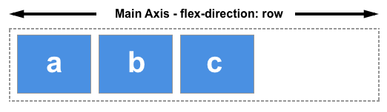
Understanding axes: row
Should you choose `row` or `row-reverse`, your main axis will run along the row in the inline direction.

Slide 13
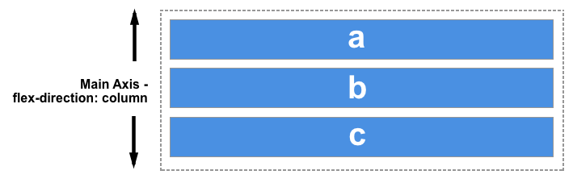
Understanding axes: columns
Should you choose `column` or `column-reverse`, your main axis will run from the top of the page to the bottom — in the block direction.

Slide 14
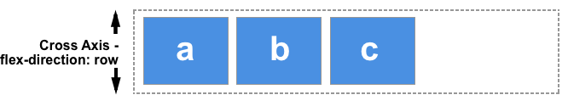
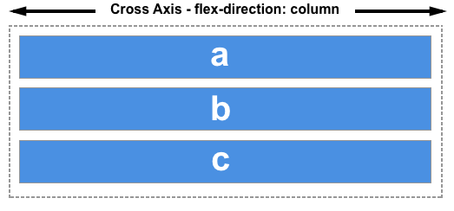
Understanding cross axes
The cross axis runs perpendicular to the main axis.
If your `flex-direction` is set to row or row-reverse the cross axis runs down the columns.
If your `flex-direction` is set to row or row-reverse the cross axis runs down the columns.

Slide 15
Wrapping content
Flexbox is one-dimensional, but you can make flex items wrap onto multiple lines by using `flex-wrap`. If items are too wide to fit onto one line, it will wrap.
.container { display: flex | inline-flex; flex-direction: row | row-reverse | column | column-reverse; flex-wrap: wrap; }
`nowrap` is the default. Using nowrap would cause an overflow if the items were not able to shrink, or could not shrink small enough to fit.

Slide 16
Flex items

Slide 17
Important flex item properties
flex-basis
It specifies the initial size of the flex item, before any available space is distributed according to the flex factors. When omitted from the flex shorthand, its specified value is the length zero.
flex-grow
This will cause the item to stretch and take up any available space on that axis, or a proportion of the available space if other items are allowed to grow too.
flex-shrink
It specifies the "flex shrink factor", which determines how much the flex item will shrink relative to the rest of the flex items in the flex container when there isn't enough space on the row.
flex-order
By default, flex items are laid out in the source order. However, the order property controls the order in which they appear in the flex container.

Slide 18
Alignment and distribution

Slide 19
Align items
The align-items property will align the items on the cross axis.
stretch
flex-start
flex-end
center
The `align-items` property applies to the container, not the items. You can use `align-self` to specify the alignment of one element.

Slide 20
Justify content
The justify-content property is used to align the items on the main axis, the direction in which flex-direction has set the flow.
flex-start
flex-end
center
space-around
space-between
space-evenly
The `justify-content` property applies to the container, not the items.

Slide 21
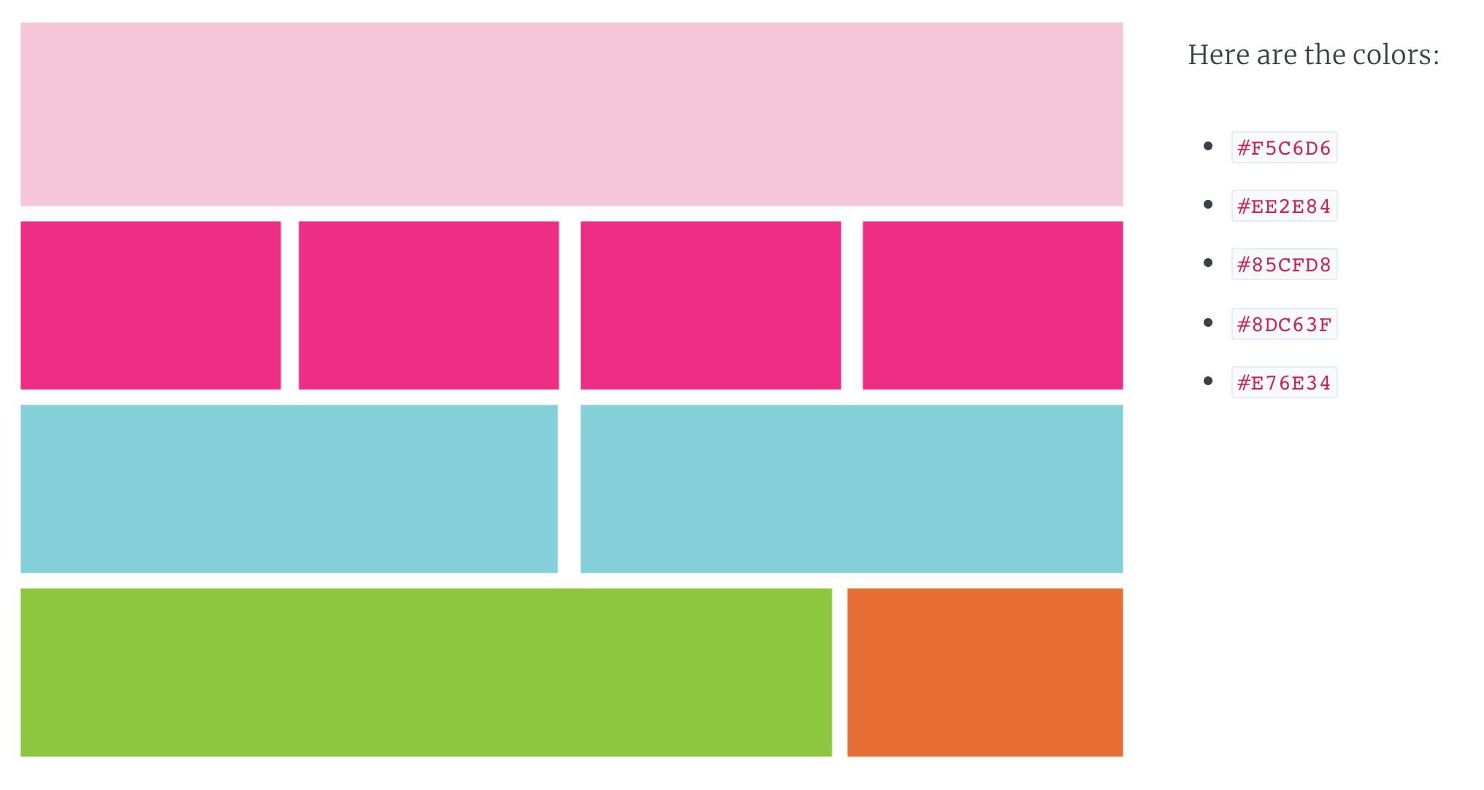
Let’s try it

